Slide 1
The Role of Exploitation
Eradication campaigns, market hunting, the pet trade and wildlife products.

Slide 2
Excerpt from: External anatomy, plumages and historic distribution of the Eskimo Curlew
… examining dates of last collection indicated that populations collapsed below levels at which birds were regularly located after the first decade of the 20th century. Afterwards, collection became rare. Indeed, even the detailed and long-term observations of MacKay (1929) yielded only 2 Massachusetts individuals by 1898 (MacKay 1899)- the last birds he reported.

Slide 3
Objectives
Investigate via case studies the consequences of exploitation in bringing about endangerment.

Slide 4
Eradication Campaigns
Eradication campaigns are less common as a cause of endangerment, but have been significant in the extinction of species like the Carolina Parrot, North America’s only parrot species, which was an orchard pest.
Case study: American Bison.
The decline of populations was due to multiple causes, including sport and market hunting. However, deliberate eradication was central to this demise.
At European contact, the range of the American Bison extended from arctic Alaska to northern Mexico and east almost to New England. Populations of two subspecies numbered 30 to 60 million individuals.
By 1870, the range had contracted to the Great Plains.
A cow and calf from the Custer State Park, South Dakota herd- one of the larger publicly held wild populations.
Within 20 years, the population was reduced to about 300 hundred individuals in isolated wild populations and private holdings.

Slide 5
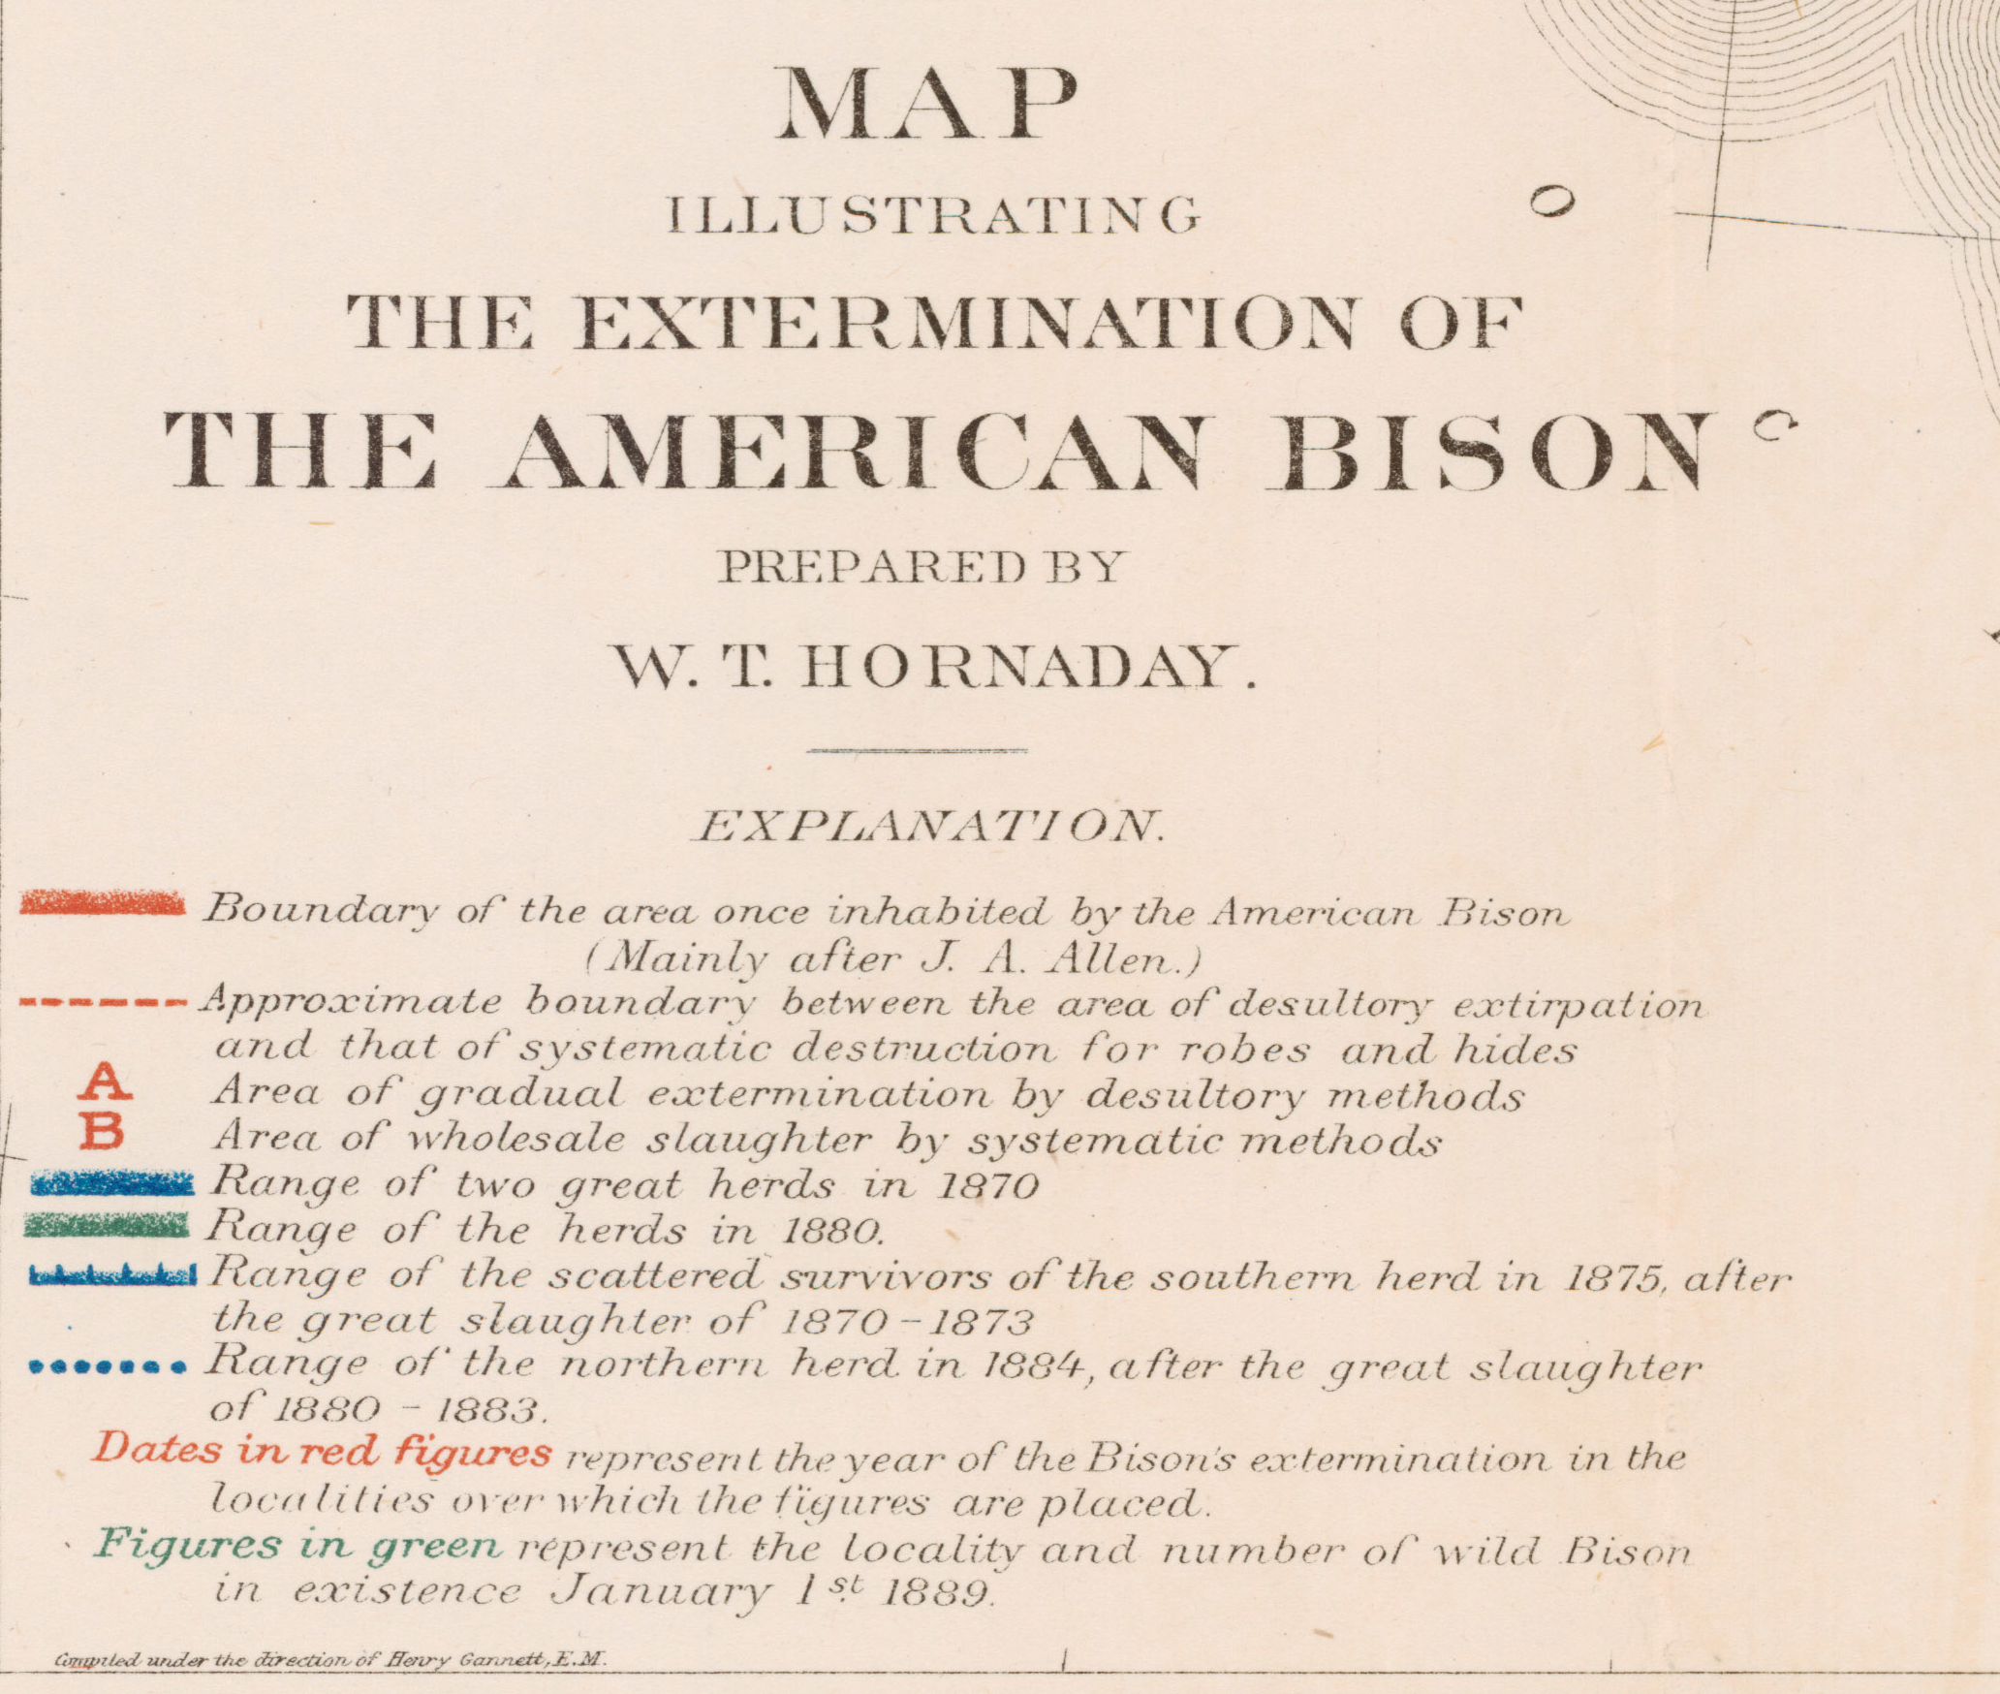
1889 U.S. National Museum report by William Hornaday

Slide 6
Bison Eradication
Two factors acted to stimulate motivation to eradicate bison:
The building of the transcontinental railroad across the range of the species.
The imperative to subdue Plains Indian tribes to facilitate this construction and to open the plains for European settlement.
The herds of bison interfered with movement along railroad lines, and sport hunters were encouraged to shoot bison in great numbers from the train.
The U.S. military was engaged in efforts to force Indians onto reservations in the late 19th century. The view was that by eliminating bison, the tribes’ ability to live independently would be eliminated as well, so they would be forced onto reservations.
1870s pile of bison skulls.

Slide 7
Market Hunting
Market hunting was common in the 19th century in the U.S. It remains common in certain parts of the world, such as in Italy, where 17 million birds are estimated to be taken during fall migration each year.
It was a factor in the extinction of the Passenger Pigeon, which was hunted throughout the year, including on the breeding grounds, although logging of the beech forests in which communal breeding occurred was likely the deciding factor.
Case study: Eskimo Curlew.
Spring and fall market hunting was also a major factor in the population decline of the Eskimo Curlew, with up to 8,000 individuals reported to have been taken during a single day.
Populations are most realistically estimated to have originally been in the hundreds of thousands, with a breeding range extending from the Canadian Northwest Territories into arctic Alaska.
Large concentrations of migrants were reported into the 1870s.
A 19th century mounted Connecticut specimen, probably from New Haven, of a fall migrant Eskimo Curlew- one of only four ever collected in the state.

Slide 8
Eskimo Curlew Hunting
By the 1880s, rapid declines were noted both spring and fall.
George MacKay’s shooting journal from Nantucket, Massachusetts provides the most detailed view of the decline during those critical years:
The last major flight occurred in 1881, although numbers had already declined since 1875.
The approximately linear decline was: Population decline = 104.82 – 0.055 (year).
MacKay’s last observation occurred in 1898.
Because spring hunts were much larger than those of fall, MacKay hypothesized that spring hunting was principally responsible for the decline.
The map at right documents all museum specimens from spring, fall and the breeding season along with their dates of collection.
Populations collapsed below the level at which individuals were recorded regularly by 1910.

Slide 9
The Pet Trade
Capture of particularly wild birds and reptiles for the pet trade can decimate wild populations.
In places like Indonesia, large scale capture of wild birds occurs.
Case study: The Bali Myna.
It is now rare in its native range, which once included the islands of Bali and Lombock. It is extinct on Lombock.
It is a prized cage bird that is heavily hunted for this purpose.
Its western population on leeward, xeric Bali, though in a national park, is now vulnerable to stochastic effects like forest fire.
Other populations have been established on small, offshore islands as well as in central Bali via captive breeding efforts.
The endemic Bali Myna now is endangered, with a total wild population of under 100.

Slide 10
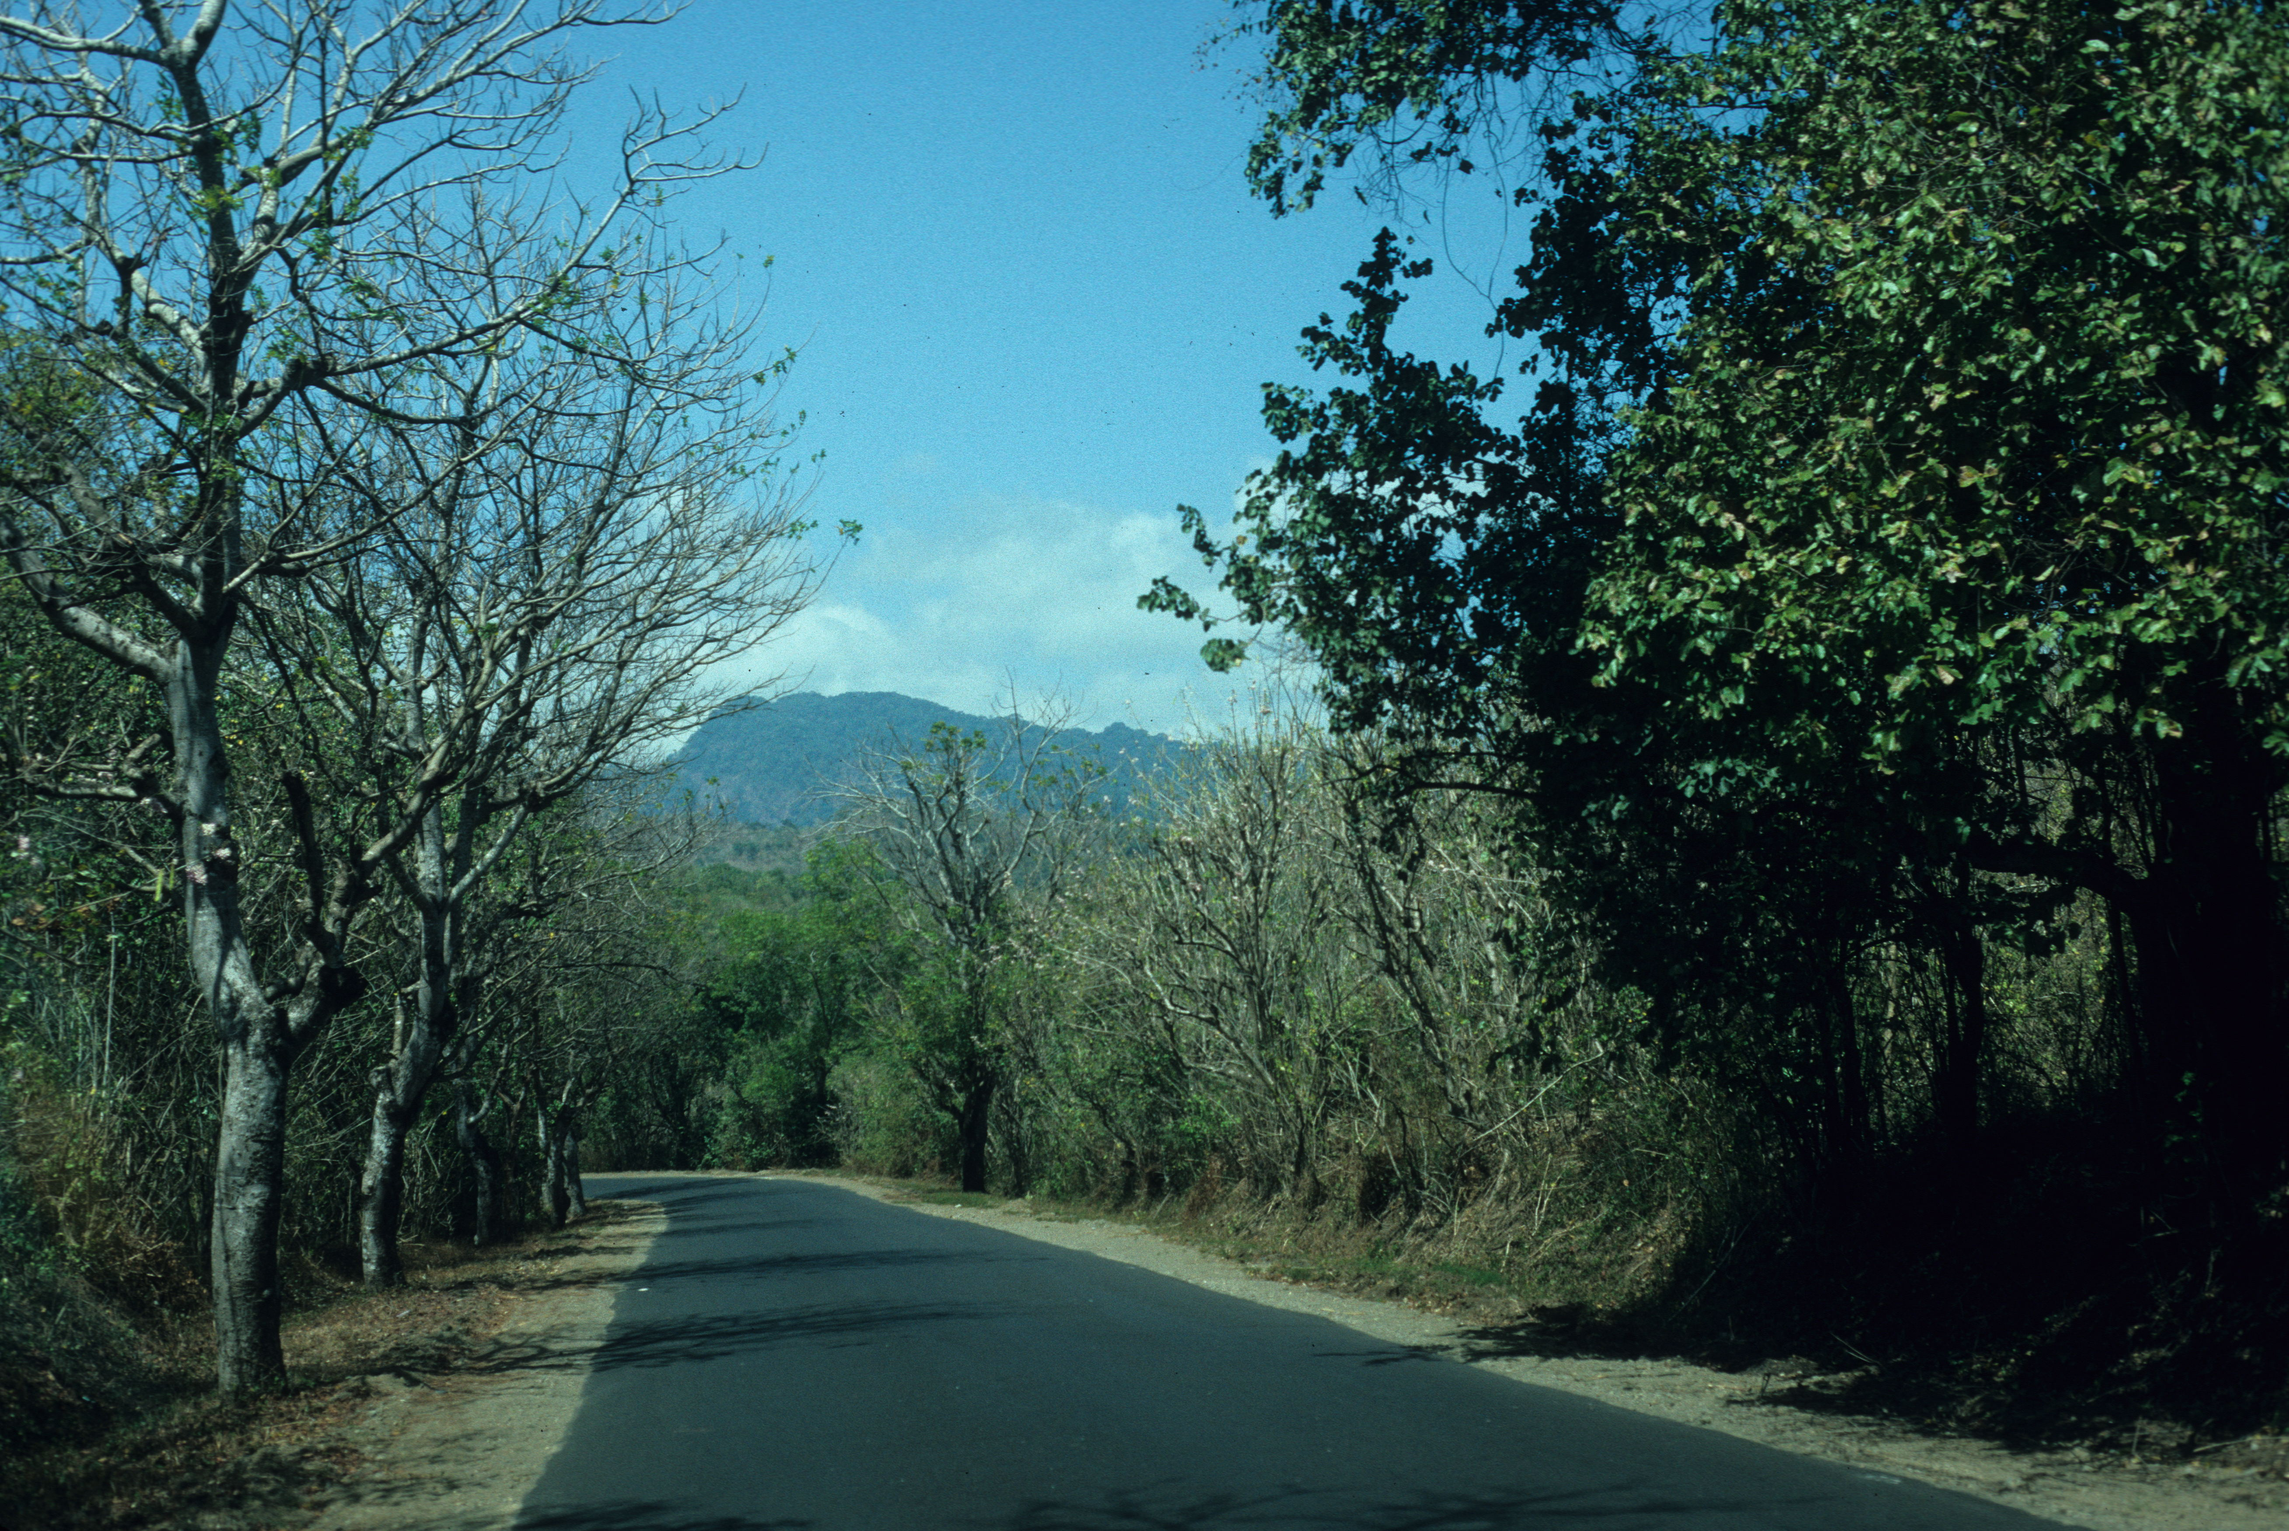
The Bali Myna
Some of these populations are not growing as expected, likely because they are being targeted by bird collectors.
Captive breeding programs now have ca. 1,000 birds, although the black market is estimated to have twice this.
Species like the White-rumped Shama can now be more common where they have been introduced in Hawaii than they are in their native Southeast Asian range.
Bali Barat National Park- the site of the last naturally-occurring Bali Myna population.

Slide 11
Wildlife Products
The harvest of wildlife for their products has occurred since prehistoric times, when bones were crafted into implements and hides made into clothing.
Horns also have been harvested for a variety of uses, most notably in recent times as ingredients in Asian medicine.
Horn is composed of the protein keratin, the same as that in fingernails and hair, so despite it having no exceptional medicinal value, a trade in rhinoceros horn exists that has driven species into precipitous population declines. Demand has risen in recent years.
Case study: rhinoceroses
The Southern White Rhinoceros of southern Africa is now the only secure species, with a total population of 21,000 descending from under 100 individuals left in the late 19th century. The northern subspecies is nearly extinct, with only two females remaining.
The Black Rhinoceros, once abundant and still numbering 65,000 in 1970, declined by 96% by 1992, when 2,300 remained in the wild. With strict protection from poaching, wild numbers have increased to about 5,500.
The Southern White Rhinoceros, once critically endangered, is now the most secure of the world’s five rhinoceros species.

Slide 12
Rhinoceros Species
The Greater One-horned or Indian Rhinoceros, reduced to under 200 individuals by 1900, has also rebounded with protection from poaching to 3,600 individuals existing in isolated populations.
The Javan Rhinoceros, once with an extensive range across Southeast Asia, was hunted to near extinction by the 1930s and is now reduced to a single population of about 65 individuals in Indonesia. Intensive protection from poaching has stabilized this population.
The Sumatran Rhinoceros, the only living relative of the Pleistocene Woolly Rhinoceros of Eurasia, has declined by 70% in 20 years due to poaching. Under 80 individuals remain in isolated populations. Efforts are underway to capture remaining individuals and relocate them to secure areas where breeding can be promoted.
Ongoing threats include continued poaching as well as inbreeding depression, stochastic population effects and habitat loss.
The once vast range of Black Rhinoceros has now contracted to isolated pockets (image courtesy of International Rhino Foundation- rhinos.org.

Slide 13
Plant Hunting
Harvest of wild products is not limited to wildlife. Plants can also be harvested to the point of endangerment.
Many populations of American Ginseng, a perennial herb of moist, rich forest, including those in southern New England, have been decimated by harvest for its roots. The root is believed to have medicinal properties- a belief supported by some, but limited evidence.
Ginseng has been brought into cultivation to supply the demand for it and to take pressure off wild populations.
Other plants, particularly tropical epiphytic orchids, have been harvested for the house plant trade to the point where wild populations have also become greatly depleted.
An American Ginseng from a wild Connecticut population.

